Slide 1



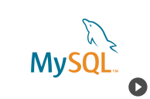
Use case 9: RESTful Microservices with Spring Boot and Hibernate
Goal: To know how to deploy a RESTful client running on Spring Boot with Hibernate and its interaction with MYSQL
Container-2 : web
Container-1 MYSQL
RESTFul Services
Host Operating System (Windows, MAC OSX, Linux)
Docker Engine
Infrastructure / Server
Introduction to Docker for Java Developers

